Slide 1
LV Functions Analysis in FlowQuant
Charles Malo
MFI Rounds
August 28th, 2009

Slide 2
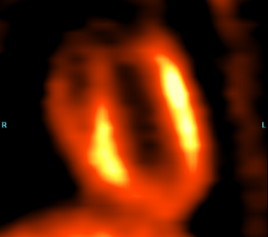
FlowQuant’s UNIX Support
Gated Report Page updates
Left Ventricle Ejection Fraction & Wall Thickening Calculation

Slide 3
UNIX Support Feature
UNIX system reliability
UNIX critical characteristics
- Case Sensitivity Mismatch
- Backward/Forward slash dilemma
- UNIX paths and tools
FlowQuant Modification for Unix Support
Limitations
- Graphical Incompatibility with earlier OS versions

Slide 4
Gated Report Page updates
Features Update
LV Slices
LV Polar Maps
Graphic Curves
LV Gated Model
GUI Control Tools

Slide 5
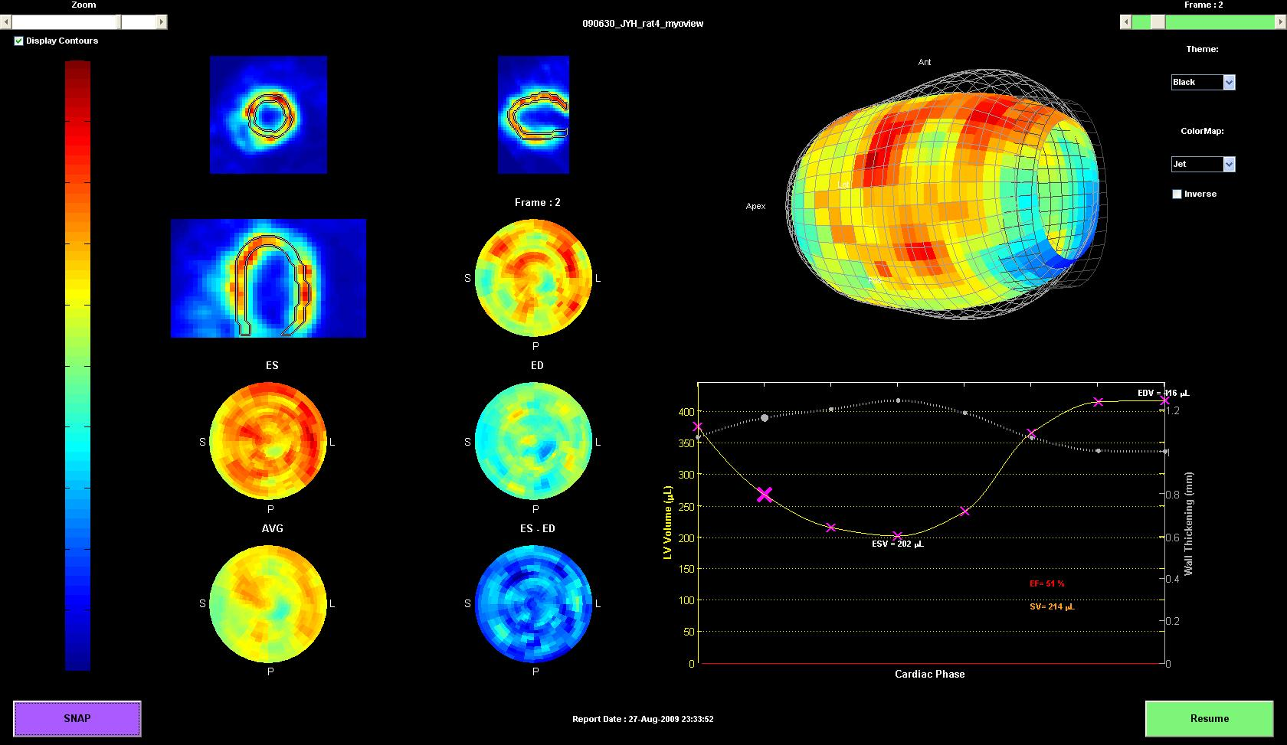

Slide 6
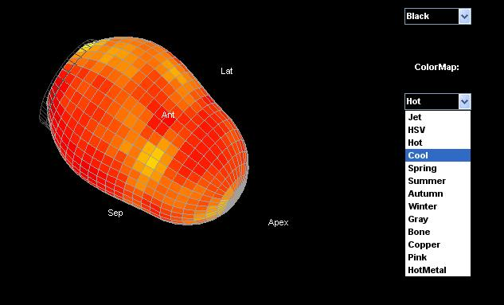

Slide 7
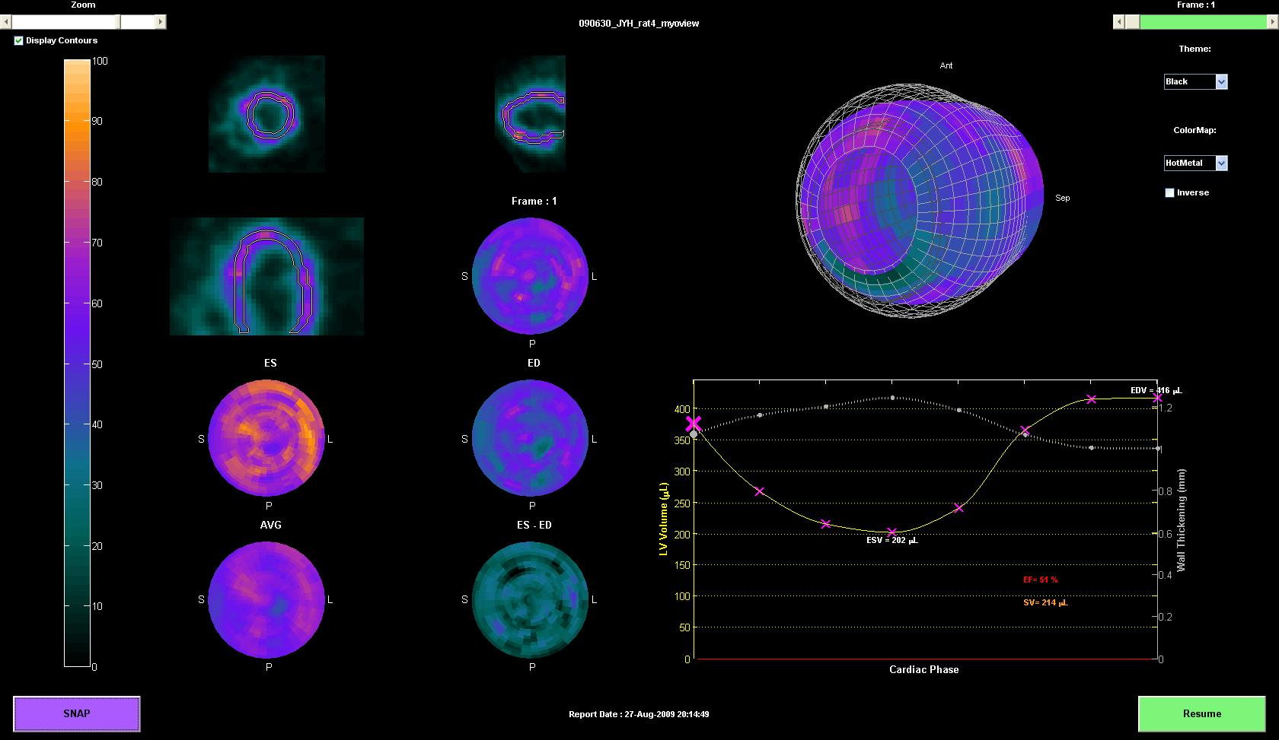

Slide 8
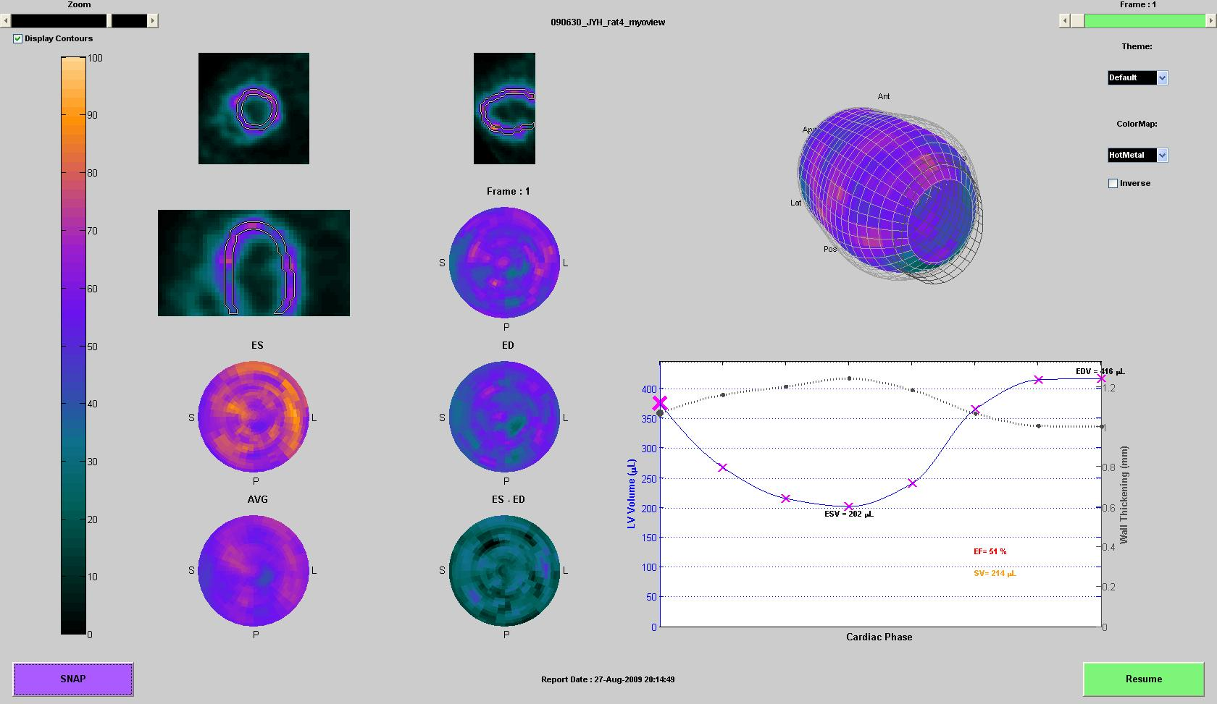

Slide 9
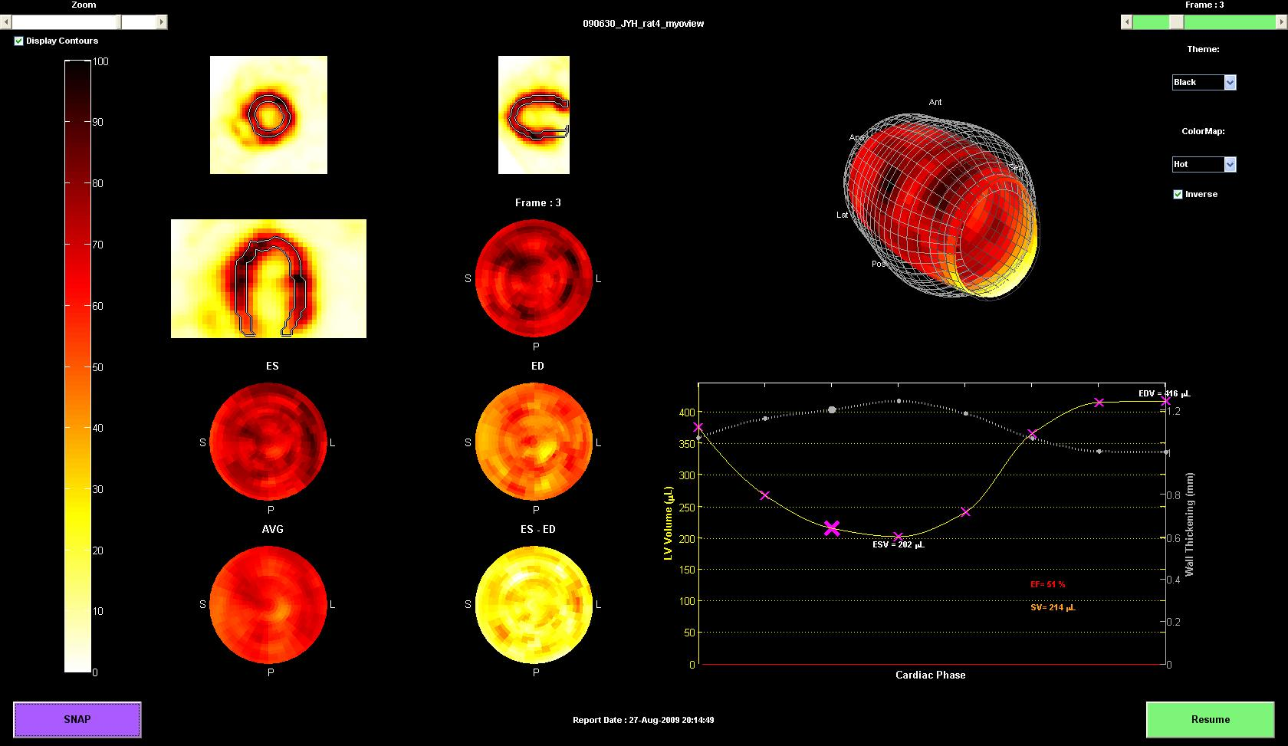

Slide 11
Left Ventricle Ejection Fraction & Wall Thickening Calculation
FACTS:
Fact 2: The myocardium wall is the thinnest at end diastole where it is “stretched” to its maximum, and the thickest at end systole, where the muscle is contracted.
Fact 1: The volume of the LV is the biggest at end diastole, and the smallest at end systole.
Fact 3: As consequence to fact 2, the uptake intensity in the myocardium is the highest at end systole and lowest at end diastole.
Fact 4: The highest uptake in the muscle is recorded along the mid-myocardium wall, i.e. equidistant to both the inner and outer cardio wall.
Fact 5: If the mass of an object and its density do not change, no matter how the shape changes, its volume is constant. This is applied for the wall muscle in my research.
Fact 6: The myocardium wall thickness is not uniform at all points in the wall, and the thickness changes throughout the phases depending on the wall’s shape.
Fact 7: A volume of an object is the areas of the slices of that object integrated along the axis from border to border

Slide 12
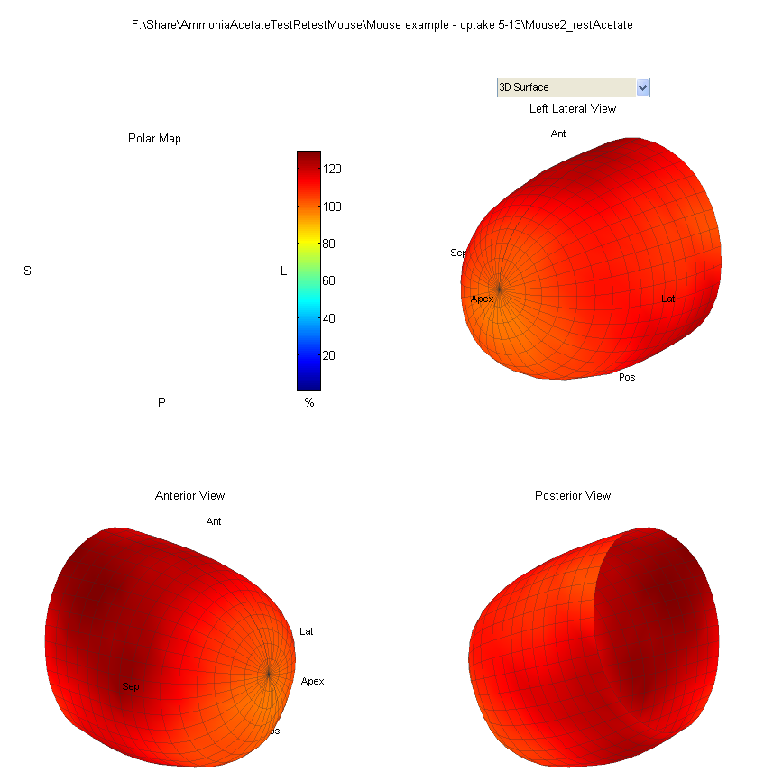
“Rough” Volume Calculations:
“Slicing” LV to equally spaced rings along SA.
Calculate number of pixels per slice covered by ROI (delimited by the frame’s set of radii)
Integrate along SA, find total pixels representing volume
Multiply number pixels by volume of a single pixel to get the volume of the ROI.
EF calculations:
EF(%)=( EDV-ESV)/EDV*100
- Problem: Underestimation of EF when WT neglected
ANT
LAT
APEX
POST

Slide 13
Wall Thickening Estimation
-Determine End Diastole Frame
-Temporary Wall Thickening assumption as starting point
-Calculate total LV volume
-Calculate cavity volume
-Determine “constant” wall volume. Assume real.
Iteratively calculate wall volume for all frame radii with small wall thickening step sizes until the best match to the real volume is made, store that WT
Recalculate volumes and the EF after subtracting the respective WT from the mid myocardium radii at that frame.

Slide 14
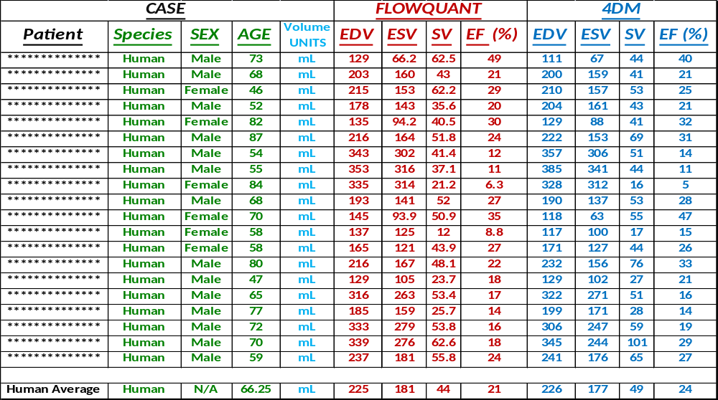
Results Comparison with 4DM
20 Random Human scans processed with both Software packages:

Slide 15
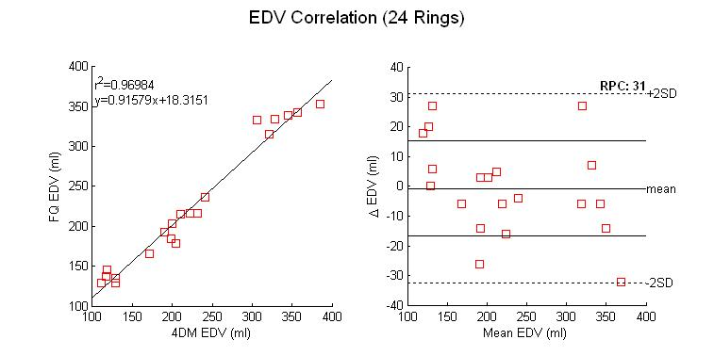

Slide 16
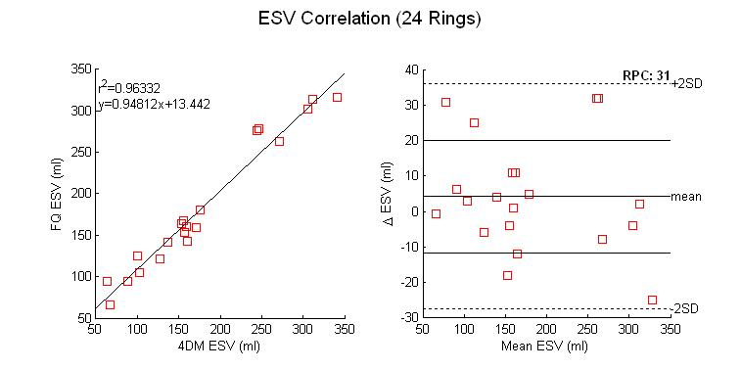

Slide 17
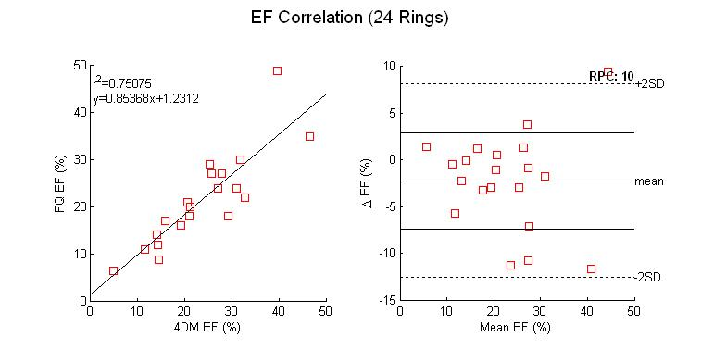

Slide 18
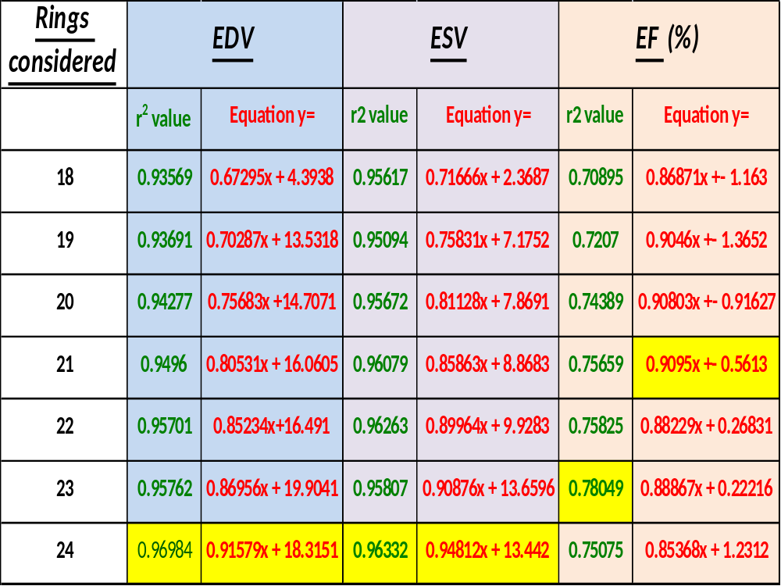

Slide 19
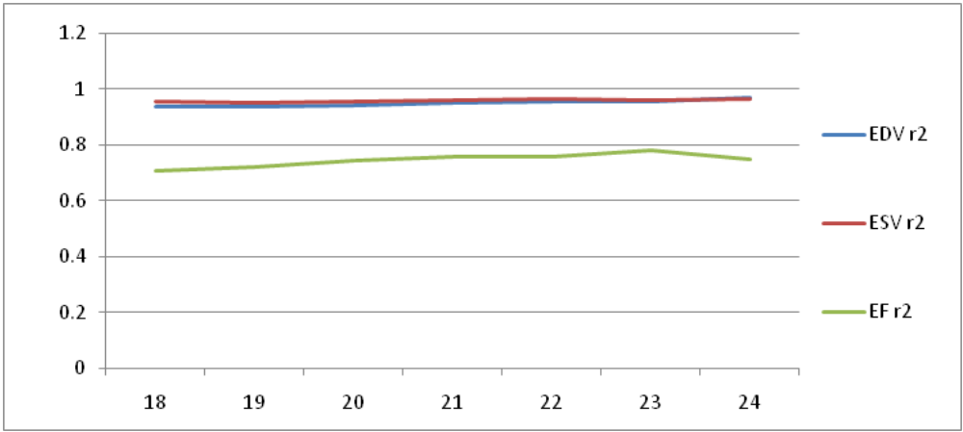

Slide 20
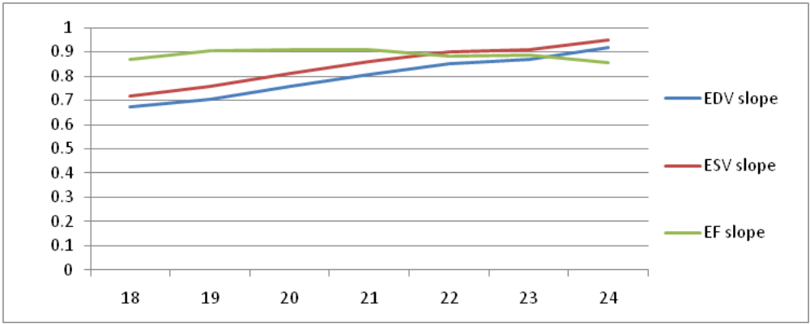

Slide 21
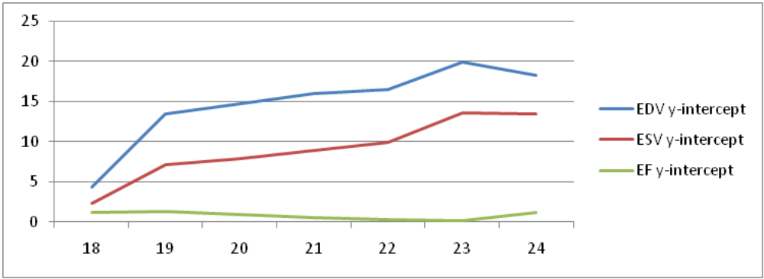

Slide 22
FlowQuant advantages over 4DM?
- FQ Automation over 4DM manual handling
=>Less user inner and inter variability
Reduced workload for clinic use
Wall Thickening Calculation feature?
Less experience needed with tools to process a scan.

Slide 23
Conclusion:
Results Valid compared to 4DM
New features add to user convenience

Slide 24
Future Outlooks:
Acquiring ability to calculate WT, can the algorithm concept be used to fix other Thickening-related limitations?
Results accuracy improved even more with a stronger WT calculating algorithm, and a valve plane location and incline detection algorithm throughout the phases?

Slide 25
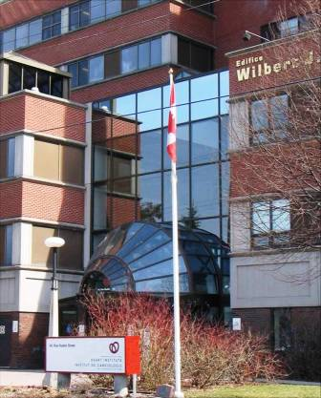


Acknowledgments
University of Ottawa Heart Institute
Dr. Rob deKemp (Supervision)
Ran Klein (Continuous cooperation)
Amir Pourmoghaddas (Assistance on Unix Environment)

